Slide 1
Migrating an Amazon RDS Oracle Database to Amazon Aurora MySQL
Team Members
Sri Sai Sanjana Dubagunta(1020360)
Mounica Ghanta(1020243)

Slide 2
Amazon RDS
easy to set up, operate
cost-efficient
Amazon Aurora
designed to deliver the speed and reliability
delivers five times the throughput of standard MySQL

Slide 3
Advantages of Aurora over Amazon RDS
Storage auto scaling
Backup
Point-in-time recovery
High Availability

Slide 4
Steps-by-step migration

Slide 5
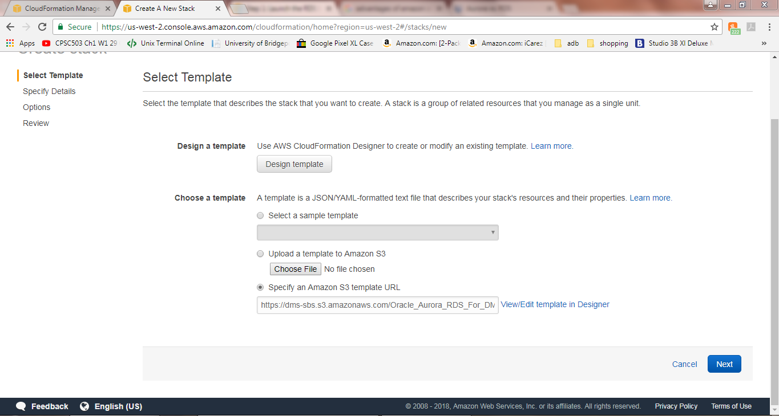
Step 1: Launch the RDS Instances in a VPC by Using the CloudFormation Template.

Slide 6
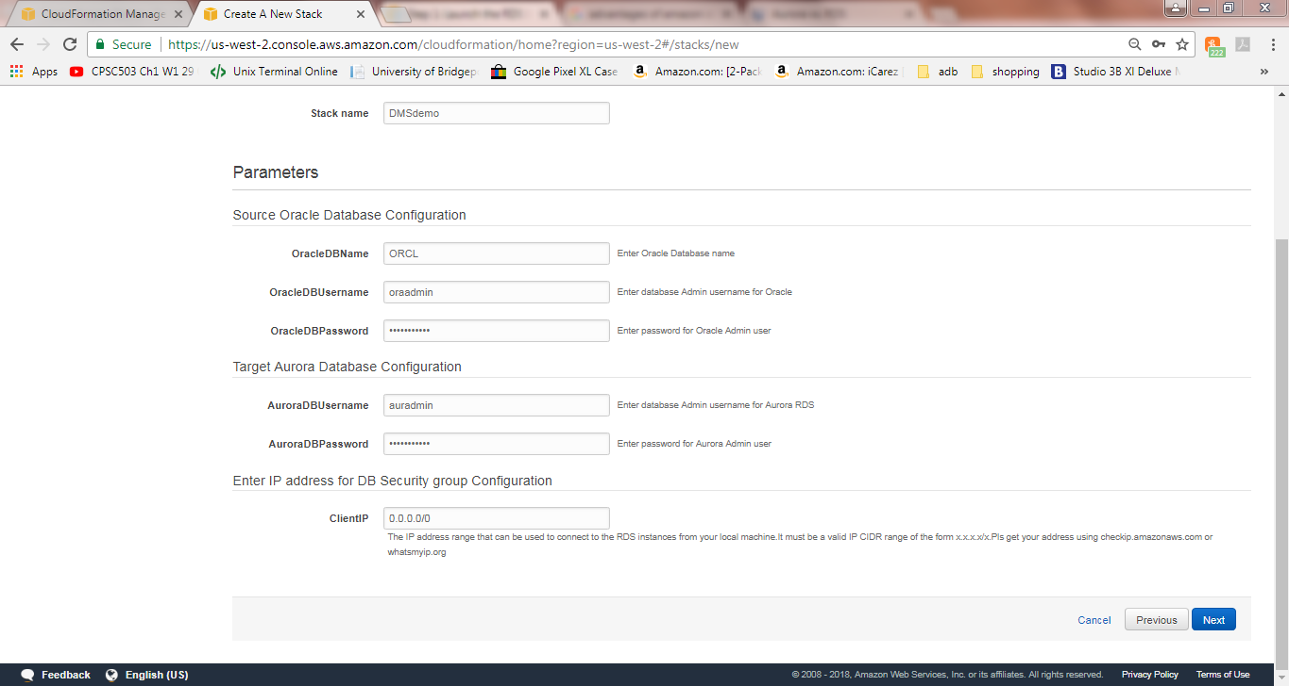

Slide 7
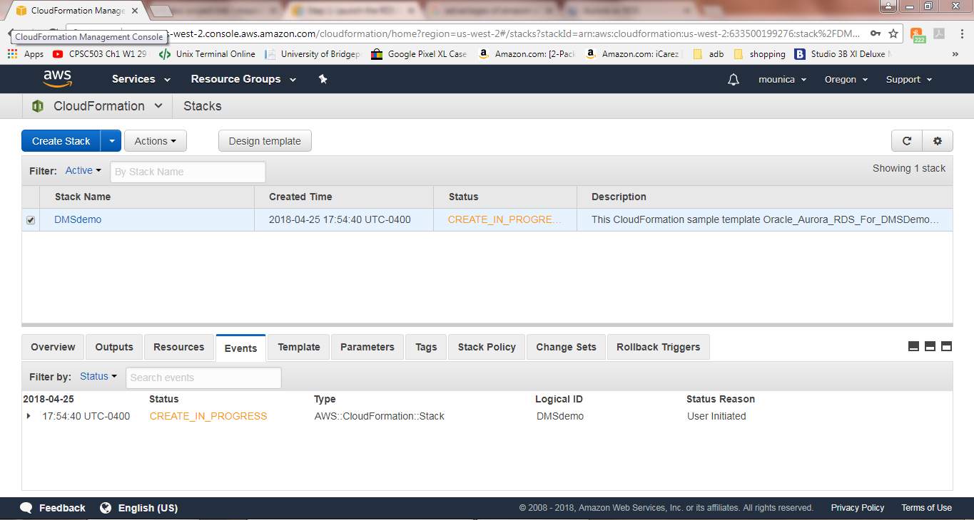

Slide 8
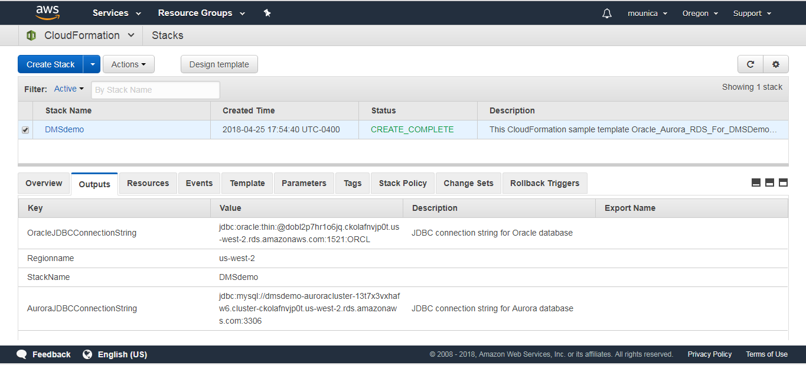
After the stack is created, select the stack and choose outputs.
Record OracleJDBCConnectionString and AuroraJDBCConnectionString for using it later while connecting Oracle and Aurora MySQL DB instances.

Slide 9
Step 2: Install the SQL Tools and AWS Schema Conversion Tool on Your Local Computer
SQL Workbench/J from the SQL Workbench/j website.
Oracle Database 12.1.0.2 JDBC driver
MySQL driver
Using SQL Workbench/J, configure JDBC drivers for Oracle and Aurora MySQL to set up connectivity
install the AWS Schema Conversion Tool and the required JDBC drivers

Slide 10
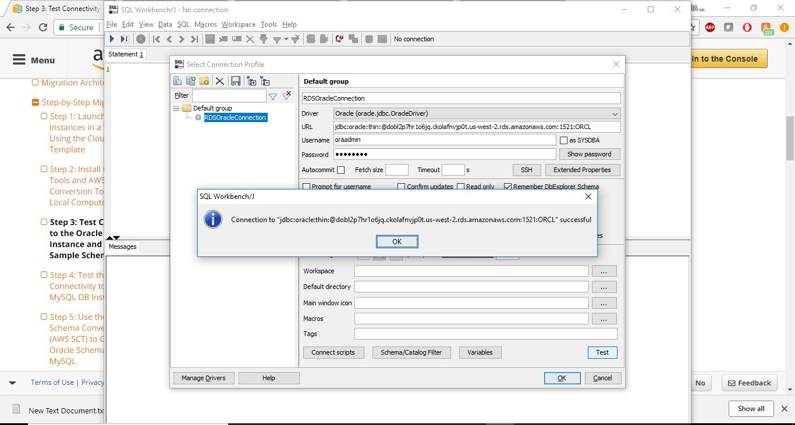
Step 3: Test Connectivity to the Oracle DB Instance and Create the Sample Schema

Slide 11
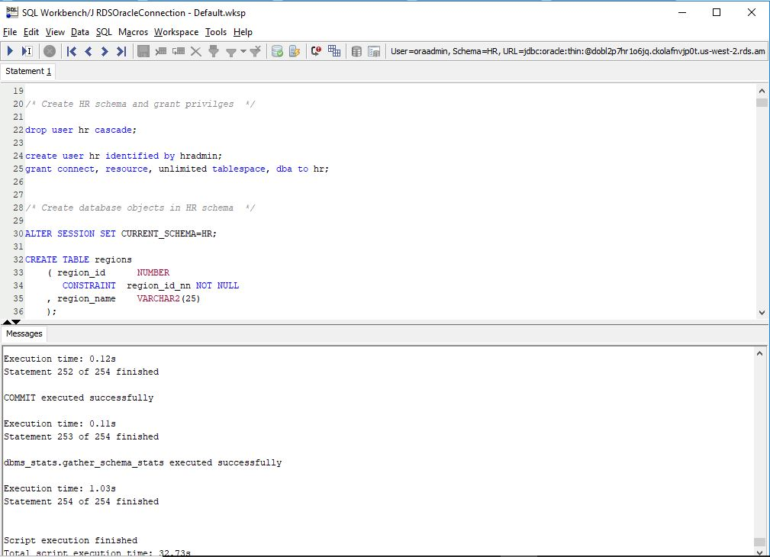

Slide 12
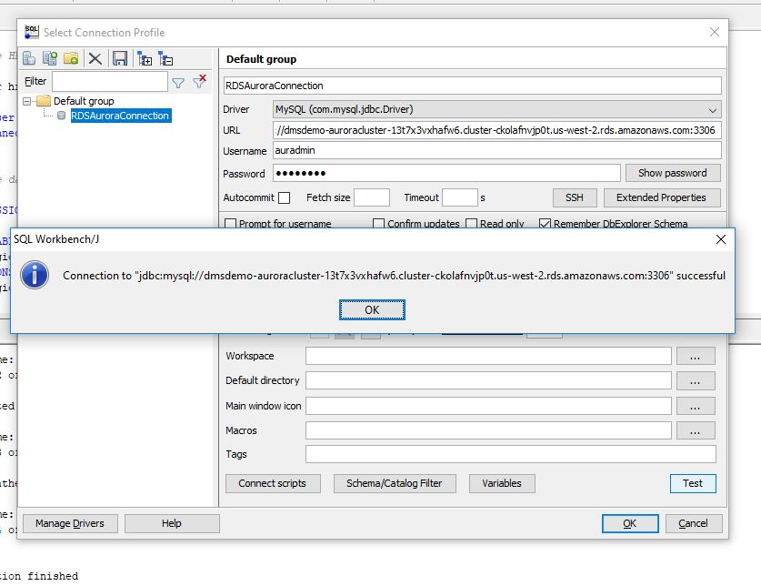
Step 4: Test the Connectivity to the Aurora MySQL DB Instance

Slide 13
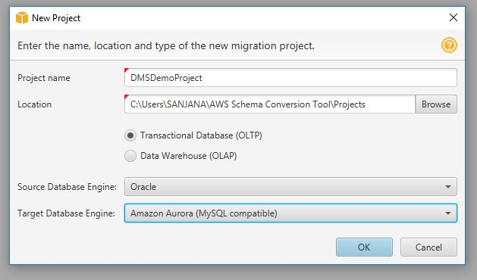
Step 5: Use the AWS Schema Conversion Tool (AWS SCT) to Convert the Oracle Schema to Aurora MySQL

Slide 14
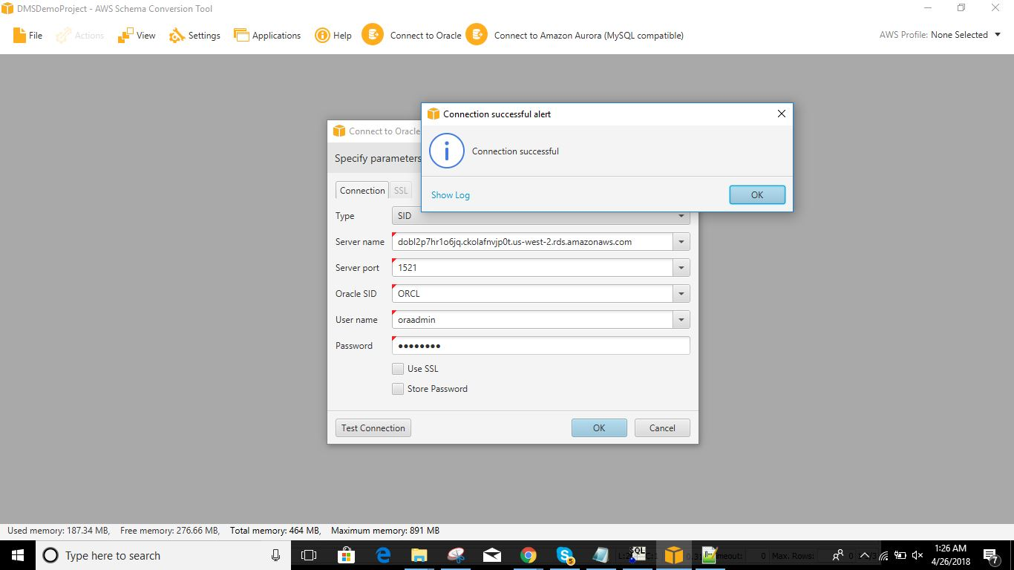

Slide 15
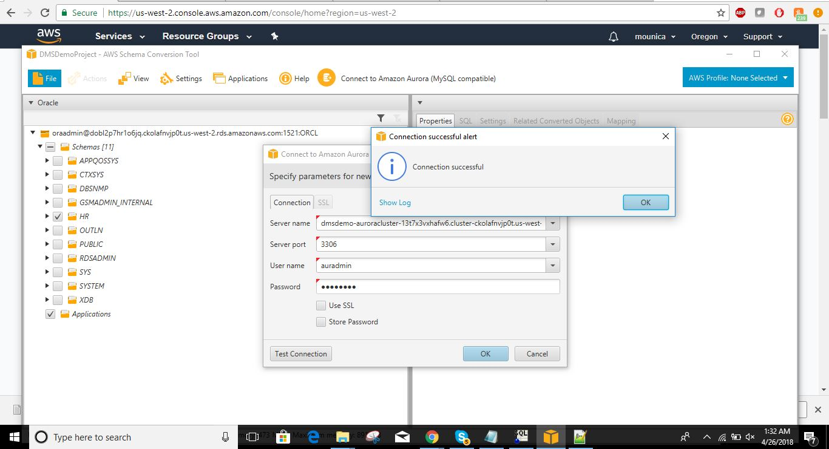

Slide 16
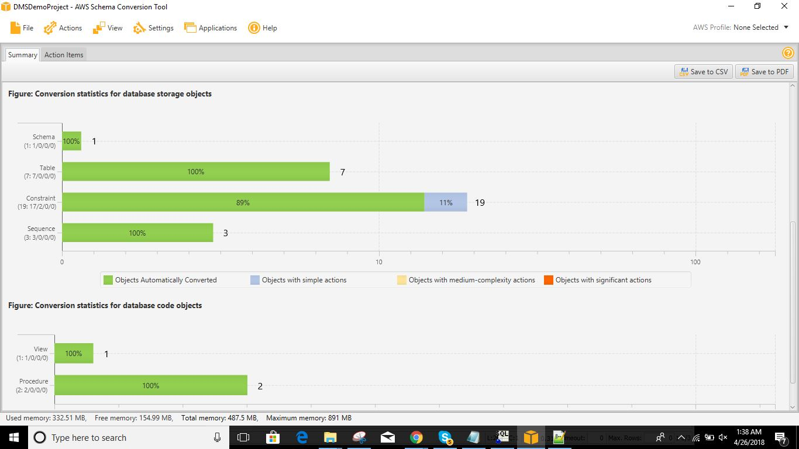

Slide 17
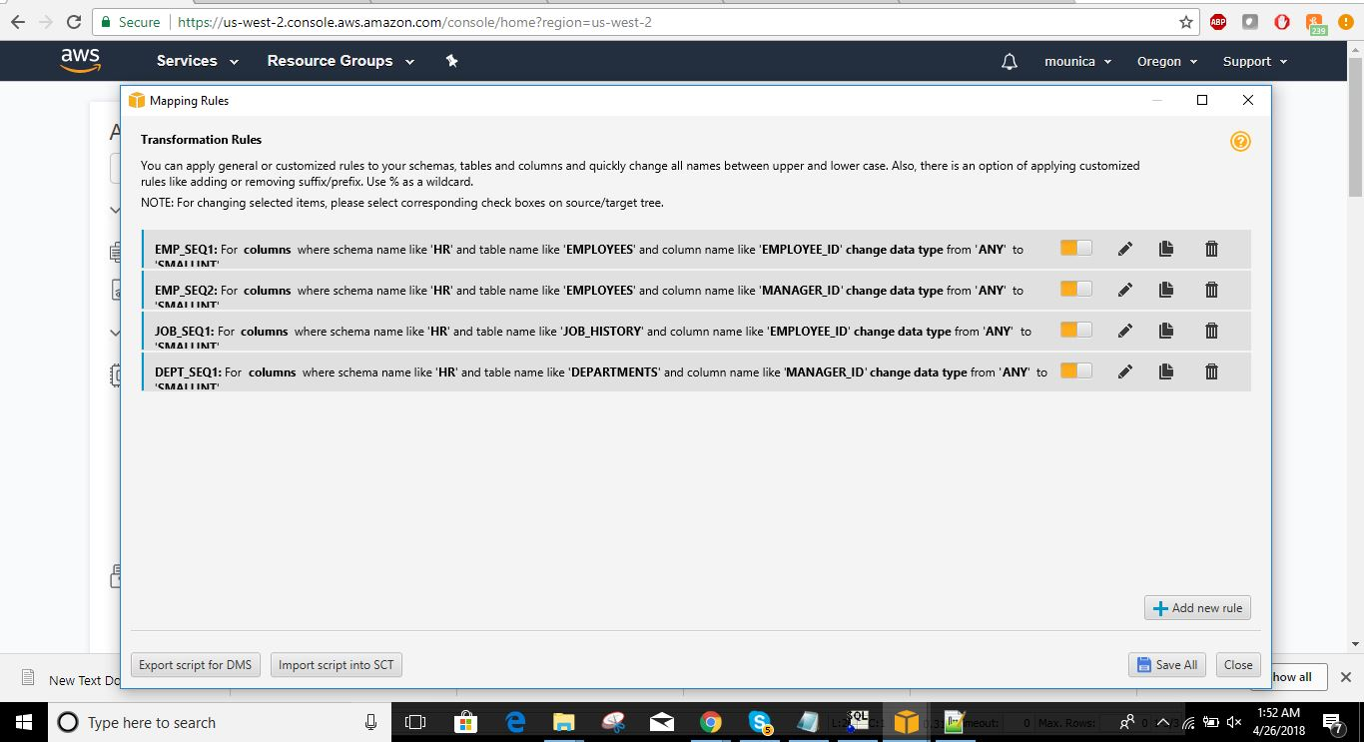

Slide 18
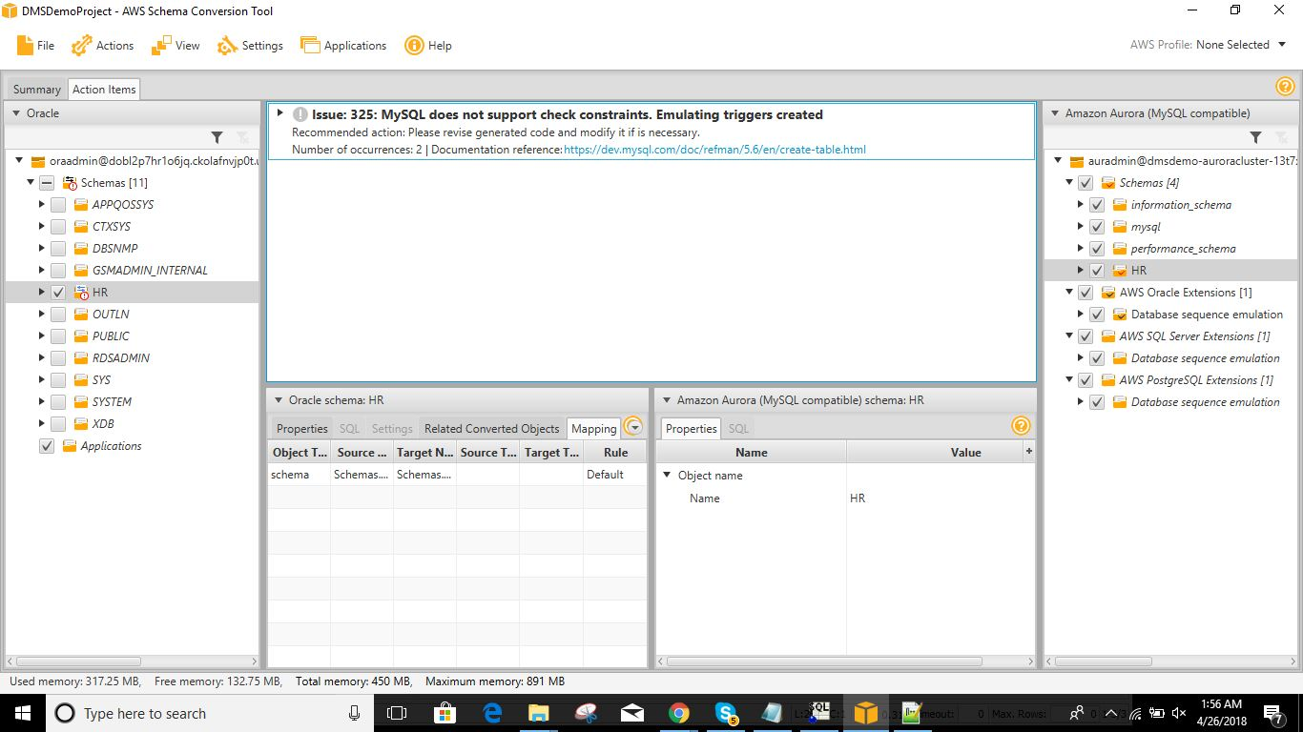

Slide 19
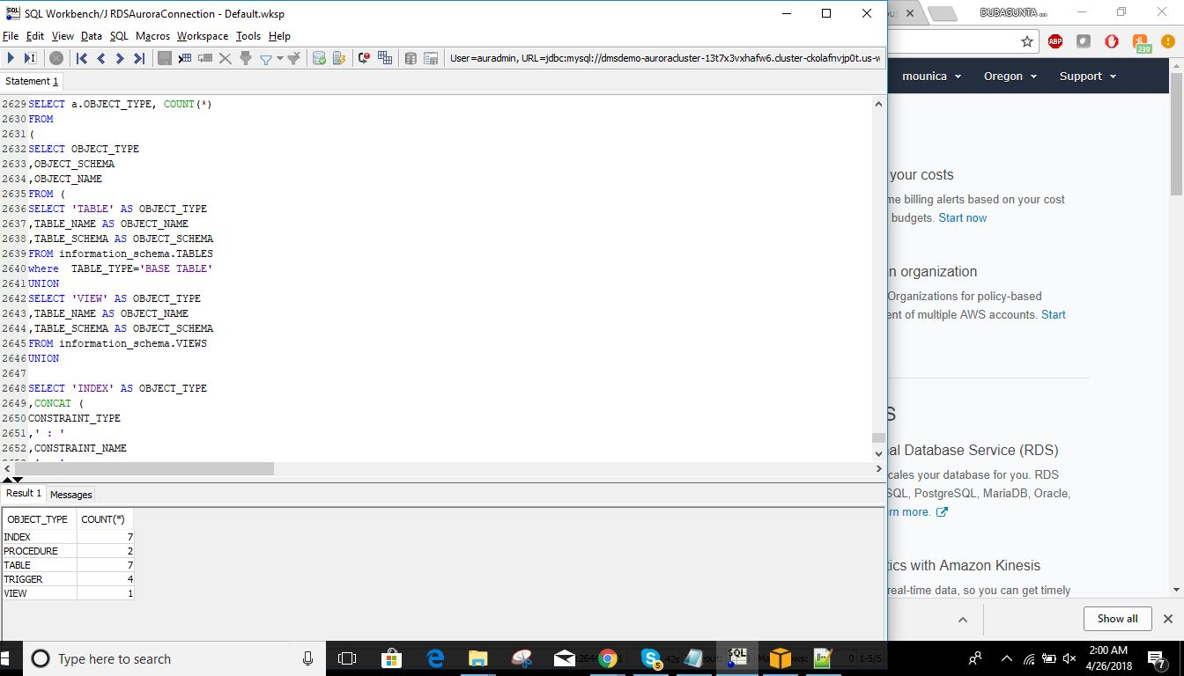
Step 6: Validate the Schema Conversion

Slide 20
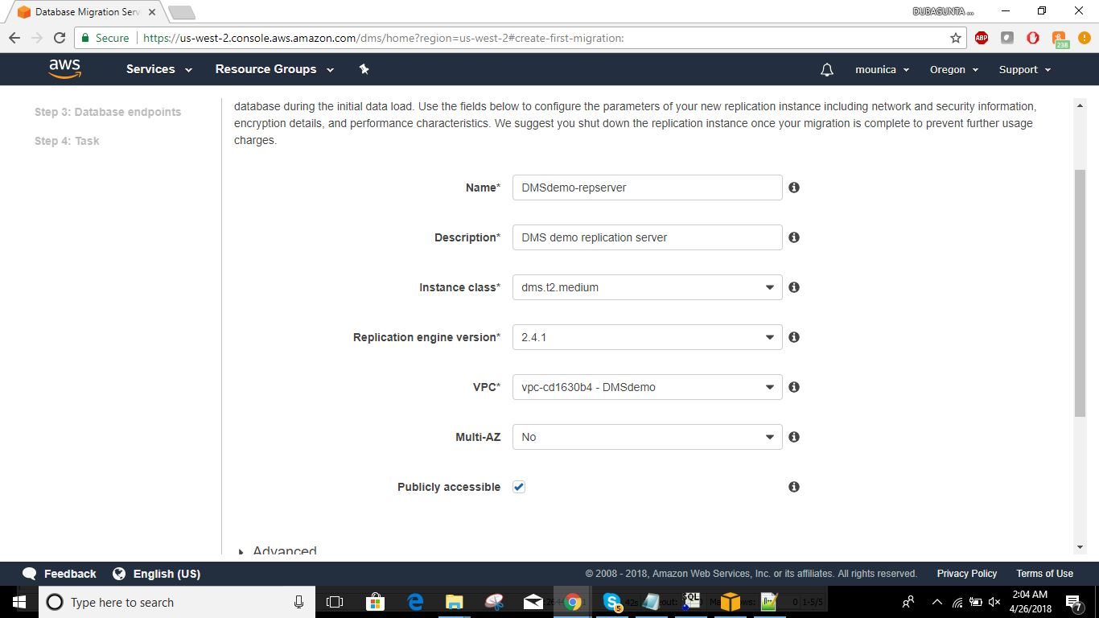
Step 7: Create a AWS DMS Replication Instance

Slide 21
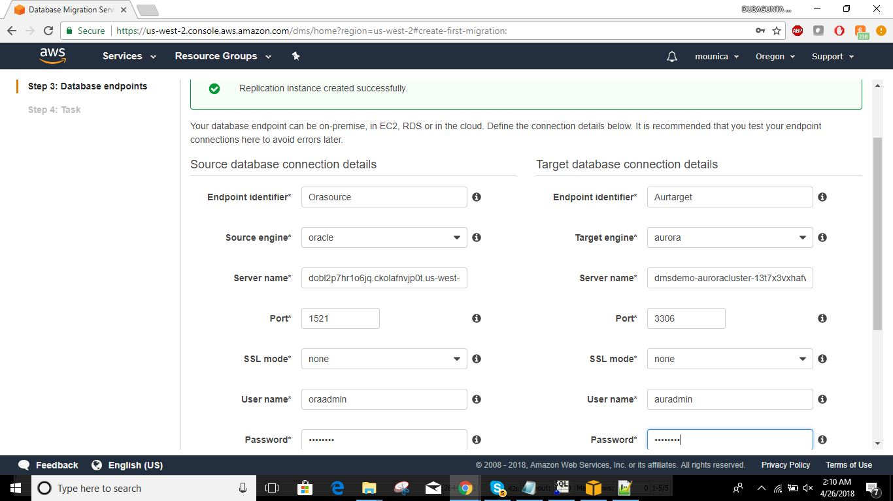
Step 8: Create AWS DMS Source and Target Endpoints To specify source or target database endpoints using the AWS console

Slide 22
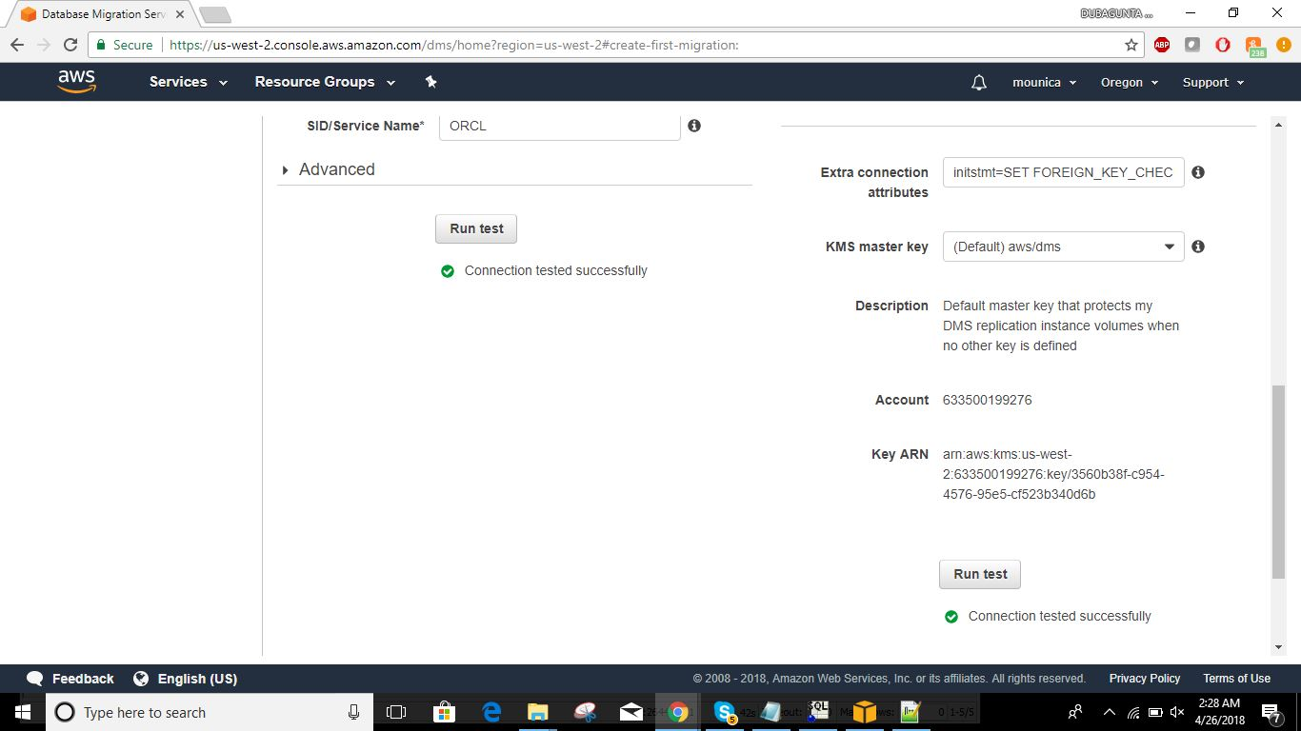
In order to disable foreign key checks during the initial data load, you must add the following commands to the target Aurora MySQL DB instance

Slide 23
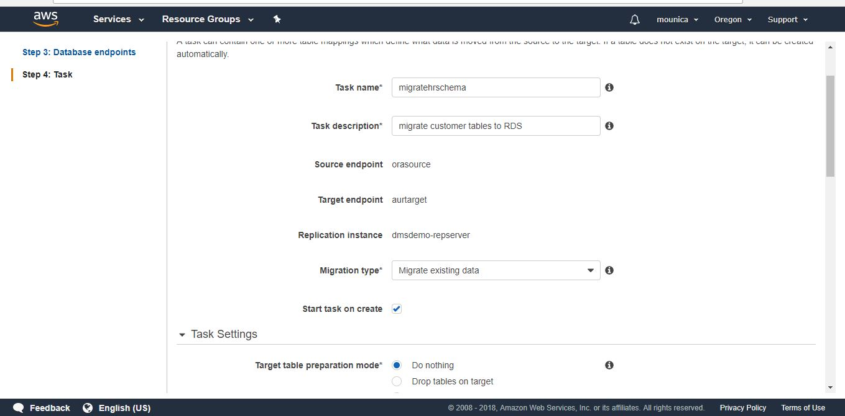
Step 9: Create and Run Your AWS DMS Migration Task

Slide 24
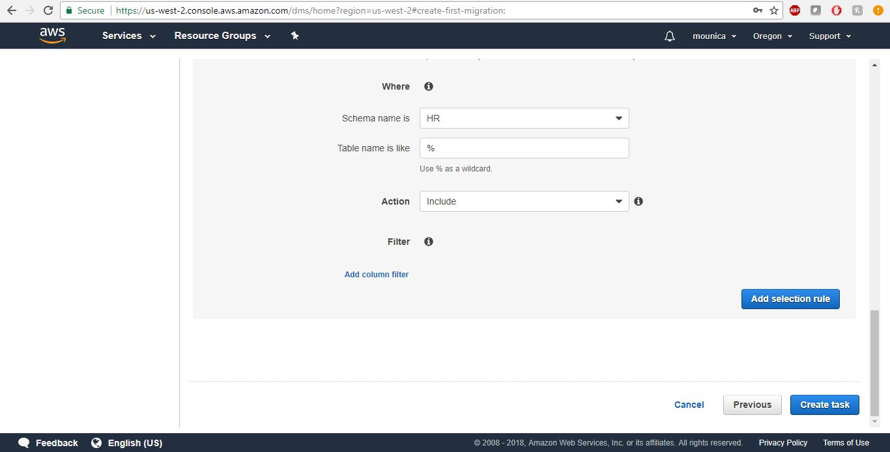

Slide 25
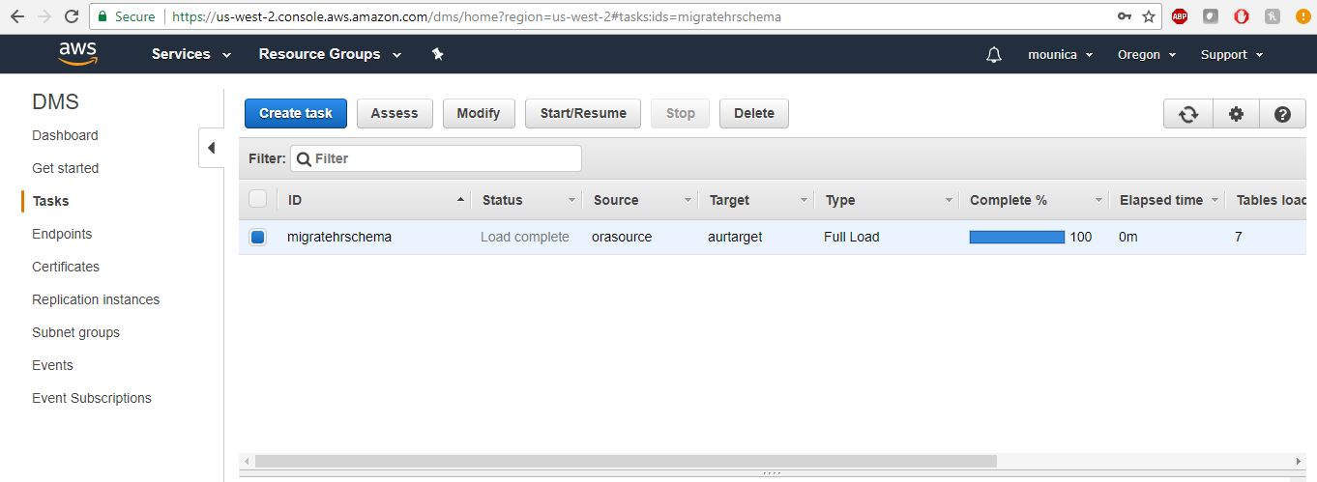

Slide 26
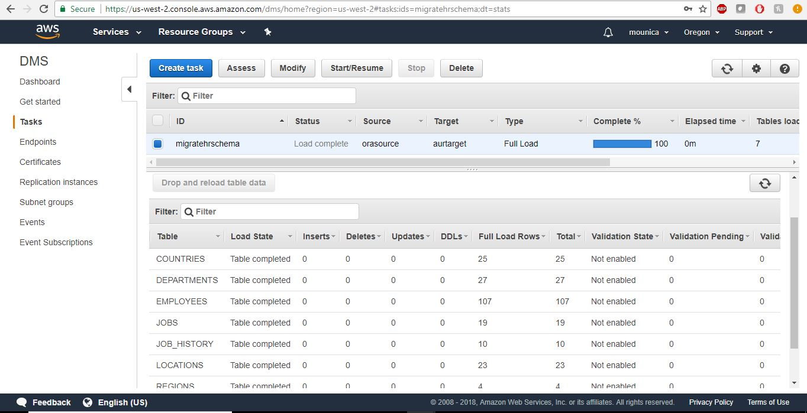
Step 10: Verify That Your Data Migration Completed Successfully

Slide 27
Thank You

